Slide 1


Assessing progress: Insights from a survey of Cooperative Extension’s growing health infrastructure
Presenters: Kate Katzman & Maggie Jones Center for Community Health & Evaluation www.cche.org
In partnership with:
Roger Rennekamp, Health Director
Kerry Gabbert, Health Associate
2023 CES Health and Well-being Infrastructure Survey Results April 5, 2024
Notes:
Outline of presentation and proposed roles:
OPENING & INTRO (~5 min) – Roger to facilitate
SURVEY RESULTS (~30 min) – Kate to facilitate, Maggie to monitor the chat
LARGE GROUP DISCUSSION (~10 min) – Maggie to facilitate, Kate to monitor the chat and capture notes
CLOSE (1 min): - Roger

Slide 2

A promising foundation
Goal of the survey: Increase our understanding of Cooperative Extension’s health equity and well-being work at the institution level.
More specifically: How have land-grant institutions grown their capacity to support our expanded role in health over the last five years?
Why five years: Significant internal and external investment in building the state and national infrastructure which supports this work. Contrasts with previous investments in individual communities.
To inform: communication, grant writing, professional development, and future work.
CE National Framework for Health Equity and Well-being available here: https://online.flippingbook.com/view/128151037/
Notes:
ROGER: The goal of the infrastructure survey was to increase understanding of the work happening regarding health equity and well-being across the Cooperative Extension System to be able to inform communications, grant writing and fundraising, and professional development opportunities. The intent is for this to be an annual survey to be able to monitor the work overtime.
The results from this inaugural infrastructure survey present an initial understanding of the progress and current status of Extension’s health-related work. The findings show promising advances in implementing the Framework, increasing capacity (funding and staffing) to engage in health-related work, and expanding community partnerships to collaboratively advance health equity and well-being in communities across the country.

Slide 3


Extension Health & Well-being Infrastructure Survey Participants
To everyone at the 51 responding institutions who took time to reflect on the questions with colleagues, corral responses from different departments, and complete the survey.
THANK YOU!
Administration of the survey emphasized the vital role of health points of contact at institutions to champion and advance health and well-being work
Pilot sites (n=8) that completed an initial version and provided feedback:
University of Rhode Island Oklahoma State University
University of Maine University of Arkansas
Iowa State University University of Minnesota
Montana State University Washington State University
Notes:
ROGER: – Take a moment to recognize those that completed the survey. A chance to emphasize what an important role in the system health points of contact play in moving this work forward. I rely on them and their support is important to the future of this work (his words). HPOC usually are…
Special recognition for the 8 pilot sites listed on the slide who participated in an informational session, provided feedback and completed an initial version of the survey.
The plan for our time today is for Kate Katzman from the Center for Community Health and Evaluation to present the results of the survey for the first 30 minutes and then Maggie Jones to lead a group discussion for our remaining time. We are interested to hear your reactions and questions about the information that is shared. With that I’ll hand it over to KATE.

Slide 4

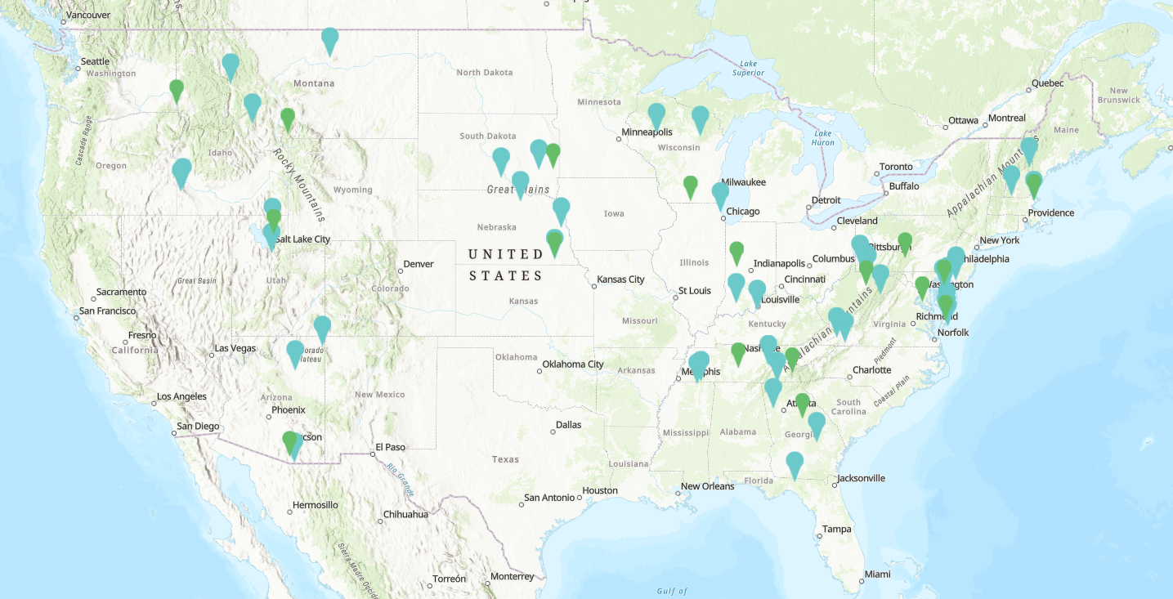
Common measures (across programs) with Kerry
Background: CCHE & Cooperative Extension
Extension evaluation & learning partner since 2019
Well Connected Communities – Waves 1-3
23 LGUs; 50 communities
Framework Readiness & Resources Assessment
National Survey
272 responses
12 LGUs
~75% county level respondents
Regional Listening Sessions
42 participants
33 LGUs (25-1862, 4-1890s, 4 Tribal)
66% county level respondents
Action:
Informed the Health Leadership Committee workplan
Development of Health Metrics Workgroup
Journal of Extension article (submitted)
Supported by funding from the Robert Wood Johnson Foundation
Supported by funding from USDA-NIFA
Notes:
KATE: As background for those that are new to the group. I work for the Center for Community Health and Evaluation (known as CCHE). CCHE has been an evaluation and learning partner with Extension since 2019. Very briefly, we work on the evaluation of the RWJF Well Connected Communities grant which is wrapping up 6 years of funding over the next year.
CCHE also worked alongside Extension in 2022 to carry out a national resources and readiness assessment related to implementing the Framework. This work was supported by USDA-NIFA.
That’s just a little bit about us, now we’ll get into talking about the survey.

Slide 5
Overview: 2023 Health and Well-being Infrastructure Survey
Purpose | Measurement: To understand and share the depth and breadth of Extension’s health and well-being efforts to date and to be able to monitor changes over time. Aiming for annual administration going forward.
Structure | Web-based survey, 23 total questions.
Timing | Pilot: August 2023 with 8 LGUs Broad administration: Sept. 20 - October 27, 2023 → Survey distributed to 76 LGUs (all 1890s and 1862s)
Content | 17 questions collecting quantitative data and 6 open-ended qualitative questions to provide additional context. Questions asked for current status (as of Fall 2023) or were retrospective (in the past 5 years) on these topics: Framework familiarity & prioritization Scope of health and well-being work Funding for health and well-being work Health and well-being leadership & staffing Community engagement & partnership
Administration | One response per LGU. Completion of the survey required engagement of multiple staff such as program leaders, administrators, and fiscal personnel.
Notes:
KATE – Roger mentioned the goal and purpose of the survey already so I’ll just describe for you briefly the structure and content. We are aiming for annual administration going forward so we will be re-administering the survey this Fall. The survey had 23 questions – 17 quant and 6 open-ended, some asking for current status and others about the past five years. I’ll talk more about the survey sample on the next slide. The content of the survey focused on these 5 topic areas in blue on the slide and his presentation will present findings from the survey in this order. Our team has also prepared a report summarizing the results of the survey that goes into more detail than we have time to cover today. DID THEY RECEIVE IT?
In terms of survey administration we asked for only 1 survey response per LGU. I want to re-iterate the gratitude that Roger shared for the LGU health points of contact that contributed to completing the survey which we know was not easy and usually required engagement with multiple personnel. Thank you.

Slide 6
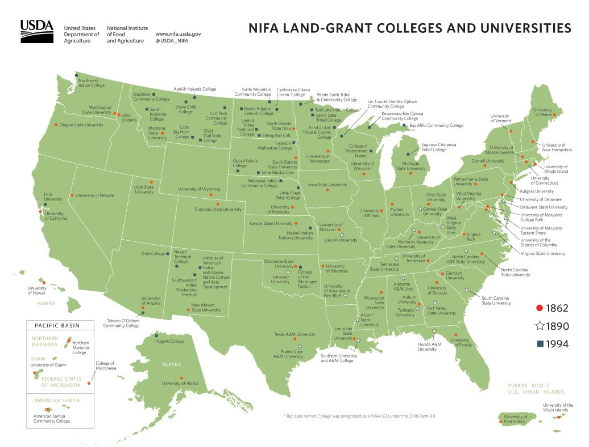
Survey: respondents
51/76 LGUs responded
67% of 1862s and 1890s
NORTH CENTRAL - 11/12 LGUs responded
21.6% of the full sample
NORTHEAST - 10/13 LGUs responded
19.6% of the full sample
SOUTH - 12/15 LGUs responded
23.5% of the full sample
WEST - 10/17 LGUs responded
19.6% of the full sample
1890s - 8/19 LGUs responded
15.7% of the full sample
Notes:
KATE - The survey was sent to all 76 of the 1862 & 1890 institutions (usually the health point of contact for that institution). We received 51 responses covering 67% of all institutions. A list of Extension health contacts at 1994 institutions was not available at the time the survey was distributed so they were not asked to complete the survey.
As you can see on the slide the Southern region followed by the North Central region represent the largest proportions of the sample. The two Extension regions with the most LGUs – the 1890 institutions followed by the Western region had the lowest response rates with 8 out of 19 1890 institutions responding and 10 out of 17 Western region LGUs responding. We call this out so you can think about regional variation with caution since not all LGUs from each region were able to respond.

Slide 7


Common measures (across programs) with Kerry
Questions for discussion at the end
What does this data tell you about opportunities or challenges the Extension system is facing?
Who else needs to see this information or could use it?
How might this information help you/this group with making the case to continue to grow health-related programming?
Additional developments in health and well-being work to share?
Notes:
Before diving into the results I wanted to let you know there will be time for questions and discussion for the last 10 min of our time together. I wanted to briefly preview the questions for the discussion so can have them in mind while I review the results. We’d like to know more from you about…. [read questions]. I invite you to add questions in the chat or hold them until the end. MAGGIE will be monitoring the chat while I present.

Slide 8
Common measures (across programs) with Kerry
Framework familiarity and prioritization
Summary: Most LGUs reported staff are at least somewhat familiar with the Framework (78%, 40/51 LGUs); the Northeast, 1890s and Southern regions had LGUs reporting staff were “very familiar”.
Rating of Framework familiarity among Extension staff (n=51 LGUs)
Notes:
KATE- At the start of the survey we asked LGUs to rate how familiar Extension staff at their institution are with the 2021 National Framework for Health Equity and Well-being. On the left you’ll see the ratings overall and on the right by Extension region. Overall 40/51 LGUs (78%) indicated their staff are at least “somewhat familiar” with the Framework with 22% (11 LGUs) reporting no familiarity. Some LGUs from the Northeast, 1890s, and Southern regions reported their staff were “very familiar”.
CCHE asked this same question about Framework familiarity of county-based staff as part of a survey in 2022 and familiarity was rated lower with only about half of respondents saying they were at least somewhat familiar. Just a note that this rating may depend on the perspective and position of those completing the survey and may not necessarily reflect how familiar county agents are with the Framework.

Slide 9
Common measures (across programs) with Kerry
Framework familiarity and prioritization
Summary: Recommendation 4 (Establish partnerships) was rated the highest priority followed closely by Recommendation 1 (Equity focus). Recommendation 5 (Advance the work of coalitions) was rated the lowest.
Priority ratings for the 5 Framework Recommendations
Notes:
KATE: Respondents were asked to rate how much of a priority each of the five high-level recommendations from the Framework were for their LGU in Fall 2023. Next to each recommendation listed on the slide you’ll see the number of LGUs that responded to that question which varied somewhat. This is because LGUs could skip questions in the survey or indicate “do not know/unsure” which are not reflected here on the slide and made up a small number of responses. For all charts in the rest of the presentation the # of LGU responses is noted on the slide.
As you can see from the darker green bars on the slide Recommendation 4 on partnerships and Recommendation 1 on health equity were rated as a “high priority” by over half of LGUs that responded to the survey. Recommendation 5 on community coalitions and Recommendation 2 on community assessment processes had the highest number of LGUs rating these as “an emerging priority” or “not a priority”.
Feedback on the results indicated institutions might have had concerns about how they would appear when rating how much of a priority Recommendation 1 on health equity was at their institution. It’s also possible institutions did not consider some recommendations a high priority because they already felt like their capacity, competency, or work in those areas was strong.

Slide 10
Common measures (across programs) with Kerry
Framework familiarity and prioritization
Summary: In-depth Recommendation 3 (Invest in the success and visibility of Extension’s health work) results signal that securing funding for health-related work is further along than having dedicated staff or practices that incentivize work focused on health and equity.
Recommendation 3: Consistency of current policies and practices (as of Fall 2023)
Notes:
KATE: In this slide you’ll see on the left-hand side the four sub-recommendations within Recommendation 3 that focus on investing in the success and visibility of Extension’s health-related professionals, programs and initiatives. On the previous slide this recommendation was rated as a priority by 83% of LGUs. This recommendation was singled out to understand in more depth since it is a key lever for supporting implementation of the Framework. The question used a 5-part scale to ask LGUs how consistent or how in place their institution’s current policies and practices are – ranging from in dark green consistently in place to grey not in place. Results on this slide tell us that securing funding for health-related work is further along than having dedicated staff or practices that incentivize work focused on health and equity.

Slide 11
Key findings from this section
Most LGUs reported staff are at least somewhat familiar with the Framework (78%, 40/51 LGUs).
Recommendation 4 (Establish partnerships) was rated the highest priority followed closely by Recommendation 1 (Equity focus). Recommendation 5 (Advance the work of coalitions) was rated the lowest.
In-depth Recommendation 3 (Invest in the success and visibility of Extension’s health work) results signal that securing funding for health-related work may be further along than having dedicated staff or practices that incentivize work focused on health and equity.
Framework familiarity and prioritization
Notes:
KATE -I will wrap up this section by reiterating the key takeaways from this section: the survey found that most staff are at least somewhat familiar with the Framework. Recommendation 4 on partnerships and Recommendation 1 on health equity were rated the highest priority by LGUs. Results focusing on Recommendation 3 indicated that securing funding for health-related work may be further along than having dedicated staff or practices that incentivize work focused on health and equity. Let’s move to the next section.

Slide 12




Common measures (across programs) with Kerry
Scope of health and well-being work
Topics with at least 80% of LGUs reporting as their health and well-being work
(n= 51 LGUs)
Nutrition education and food safety (n= 48 LGUs)
Agricultural safety (n= 47 LGUs)
Chronic disease prevention and management (n= 47 LGUs)
Food systems and security (n= 47 LGUs)
Youth development with a focus on health and well-being (n= 47 LGUs)
Physical activity (n=45 LGUs)
Mental health and stress management (n=44 LGUs)
Water quality (n=43 LGUs)
Substance misuse prevention (n=41 LGUs)
Work on 9/17 health topics was most often reported under LGUs’ Family and Consumer Sciences (FCS) unit*
*Respondents could select more than 1 Extension unit: 4-H, Agriculture and Natural Resources, Economic and Community Development, Family and Consumer Sciences (FCS), and/or Other unit (they could select all that apply).
Notes:
KATE- In this part of the survey we asked institutions if 17 pre-populated health and well-being topics were a part of the scope of their health and well-being work. In order from the top of the slide are the most frequently reported health topics with at least 80% of LGUs reporting these topics as a part of their work with the top 5 in darker blue.
As part of the questions in this section respondents were asked to indicate which Extension unit their work on each topic falls under. They could choose more than one unit. For 9 out of the 17 health topics LGUs reported that the work falls under their Family and Consumer Sciences (FCS) unit (among those LGUs that have this unit at their institution). ….I’ll talk later about cross-program partnership across these same health topics.

Slide 13
Common measures (across programs) with Kerry
SNAP-Ed and EFNEP
Critically important to Cooperative Extension’s overall funding and staffing portfolio and contributes to significant health and well-being programming at LGUs.
Together they reach more than 2 million individuals and families with nutrition information and catalyze community-based efforts focused on policy, systems, and environmental change.
Nearly $300 million each year supports this work. Brings diversity to Extension in terms of staff and participants.
Not included in the infrastructure survey because it was data already available through other sources.
Notes:
KATE: I want to talk for a moment about SNAP-Ed and EFNEP. We know these two programs are critically important to Cooperative Extension and contribute significantly to health and well-being programming at institutions. Together these programs reach more than 2 million individuals and families with nutrition information and catalyze community-based efforts focused on policy, systems, and environmental change. Nearly $300 million each year supports this work and with it comes diversity to Extension’s staff and participants. In the survey institutions were asked to exclude SNAP-Ed and EFNEP from their responses given that data is already available through other sources and funding levels are determined externally based on eligible populations. With this data we have a better understanding of health and well-being programming above and beyond what SNAP-Ed and EFNEP contribute.

Slide 14
Common measures (across programs) with Kerry
Funding for health and well-being work
Summary: The total estimated amount of external funding reported was about $140 million (n=38 LGUs) in 2023. The distribution of external funding estimates by LGU was large with the highest number within the $1 - $3 million range.
~$140,000,000
Estimate of 2023 external funding focused on health
(n=39 LGUs) excluding SNAP-Ed and EFNEP funding
Number of LGUs by reported funding amount (n=38 LGUs):
$1-$500k | $500k-$1 mill | $1-$3 mill | $3-$10 mill | $10 mill +
10 | 3 | 15 | 6 | 4
Notes:
KATE: Now let’s talk about funding for health and well-being work reported in the survey. In total 38 LGUs estimated $140 million in external grant funding for health and well-being work in 2023. This funding amount was very difficult for institutions to respond to. 12 LGUs were not able to answer and 1 indicated they received zero funding primarily focused on health. The distribution of funding amounts by LGU was a large range with the highest number landing in the $1 - $3 million bucket.

Slide 15
Common measures (across programs) with Kerry
Funding for health and well-being work
Summary: Most LGUs (82%, 41/50 LGUs) increased external funding for health over the last 5 years, while less than half increased internal funding. Almost all LGUs that increased internal funding also increased external funding suggesting more funding can lead to more funding.
Changes to funding primarily focused on health in the last 5 years* (2018-2023)
High Obesity Program (HOP) funding, concentrated in the Southern and North Central regions, was associated with increased external funding focused on health.*
*Associated with doubling external funding, Chi-squared test, P<.001
9/18 LGUs were from the Southern Region
*not including SNAP-Ed and EFNEP funding
Notes:
KATE: On this slide we are looking at changes to funding over the last 5 years. The top bar is looking at internal funding - Any funding within the institution including internal resource allocation or “core” funding that support staff and other costs. The bottom bar is looking at any funding outside the institution including grants and contracts external to Extension. We see in this bar that 41/50 LGUs (82%) increased external funding for health in the last 5 years while only 23/49 LGUs (47%) increased internal funding for health. Almost all LGUS that increased internal funding also increased external funding suggesting that more funding can lead to more funding. There was not a lot of regional variation in responses except for two areas pointed out on this slide: 1) The Western and Southern regions had the most LGUs reporting increased internal funding for health in the last 5 years. 2) The Southern region had the highest number of LGUs reporting their external funding significantly increased. Significantly increased was defined by funding that “more than doubled” in the past 5 years.
USE ANIMATION TO BRING IN BLUE BOX ON HOP FUNDING:
Our team ran some significance tests and found that having High Obesity Program (HOP) funding is associated with increased external funding focused on health in the past 5 years which likely includes HOP funding itself. There was no significant relationship between for the other national health grants we looked at (EXCITE and WCC). HOP LGUs are concentrated in the Southern region which may account for some of the regional differences on this slide.
There were a couple limitations in our analysis I’d like to point out: we did not control for the size of the LGU which could be predictive of levels of funding and staffing. Secondly, we did not account for differences in federal capacity funds received by 1862 and 1890 institutions. These differences mean 1862 and 1890 institutions do not have the same opportunities to increase health and well-being infrastructure, particularly for funding and staffing.

Slide 16
Key findings from this section
The total estimated amount of external funding reported was about $140 million (n=38 LGUs) in 2023. The distribution of external funding estimates by LGU was large with the highest number within the $1 - $3 million range.
Most LGUs (82%, 41/50 LGUs) increased external funding for health over the last 5 years, while less than half increased internal funding. Almost all LGUs that increased internal funding also increased external funding suggesting more funding can lead to more funding.
High Obesity Program (HOP) funding, concentrated in the Southern and North Central regions, was associated with increased external funding focused on health.
Funding for health and well-being work
Notes:
KATE – Just to briefly summarize the results from this section: 38 LGUs estimated about $140 million in external funding for health and well-being work outside of SNAP-Ed and EFNEP funding in 2023. Most LGUs increased external funding for health in the past five years. HOP funding was associated with increased external funding focused on health.

Slide 17
Common measures (across programs) with Kerry
Health and well-being leadership and staffing
Summary: Leadership for health and well-being work was most frequently described as part of the Family and Consumer Sciences program area. 21/51 LGUs (41%) changed their leadership structure in the last 5 years.
The presence of a dedicated unit/center leading health and well-being work was associated with increased internal funding for health.^
Leadership structure for health and well-being work (n=50 LGUs)
Examples of dedicated units/programs:
Family & Community Wellness
Integrated Health Disparities
Health & Well-Being Institute
Family, Health & Well-being
Human Sciences Program
^Chi-squared test of independence, p<0.02
* Other included being at the beginning stages; having too few health and well-being staff; 2+ programs leading the work; or the work under a program other than FCS
Notes:
KATE - Now we will talk about leadership structure that supports health and well-being work at Extension institutions. The most commonly reported leadership structure by 48% of institutions was that health and well-being work is a part of the Family and Consumer Sciences program area. This was followed by having a dedicated/unit/center leading the work. Some examples of names of dedicated units or programs for health and well-being work are on the slide. In our analysis we found that the presence of a dedicated unit/center leading health and well-being work was associated with increased internal funding for health.
We also asked about change in leadership structure in the past 5 years. Just over half of LGUs (53%) indicated their leadership structure had not changed in the last 5 years. For the 21 LGUs that reported change had occurred they described changes as adding interdisciplinary outcome teams, merging/creating new program areas, renaming FCS to better align with their work, and adding a state-level position for health.
In the next slide we’ll talk about staffing.

Slide 18
Common measures (across programs) with Kerry
Health and well-being leadership and staffing
Summary: LGUs estimated they currently have about 960 dedicated (100% FTE) health and well-being positions with half of LGUs indicating these positions make up 1-10% of their workforce. Health-related state-level positions increased the most while LGUs reported the least amount of change in district/regional positions.
Changes to health-related staff in the last 5 years* (2018-2023)
Ways LGUs increased interns and practicum students:
Increased collaboration with their public health program (MPH and BSPH).
Federal HRSA grants that fund full scholarships for students who select internships with Extension.
*not including SNAP-Ed and EFNEP staff
Notes:
USE ANIMATION TO ONLY SHOW SUMMARY FIRST
KATE - The survey asked about the current number of dedicated (or those with 100% FTE) heath and well-being positions. In keeping with the questions about funding, LGUs were asked to exclude SNAP-Ed and EFNEP staff when thinking about their responses. In total LGUs estimated having about 960 dedicated health and well-being positions with about half of LGUs indicating these dedicated positions make up 1-10% of their workforce. Feedback on the results indicated that the 960 number may be a gross underestimate of staff working on health and well-being work since staff that work partially on SNAP-Ed and EFNEP were excluded.
ADD THE CHANGES CHART
Now we’ll look at changes to health-related staff in the last 5 years. Looking Looking at the distribution of type of staff engaged in health and well-being work, a little over half of LGUs increased health-related state-level positions and intern and practicum students. LGUs reported the least amount of change in district/regional and AmeriCorps positions. The grey bars are on this slide are where LGUs indicated they didn’t have these position type at their institution. In qualitative comments for this section three institutions named funding shortages that did not allow them to maintain or add staff.
ADD BLUE BOX
In comments LGUs mentioned a couple ways they were able to increase intern and practicum students – through collaboration with their on campus MPH or BSPH programs or through federal grants that fund scholarships for internships with Extension

Slide 19
Common measures (across programs) with Kerry
Health and well-being leadership and staffing
Summary: LGUs indicated equitable hiring practices currently are or are emerging as a priority and play a key part in integrating health equity as a core system value.
Priority level ratings for 7 equitable hiring practices*
*Adapted from California Department of Public Health. "Baseline Organizational Assessment for Equity Infrastructure.” https://www.cdph.ca.gov/Programs/OHE/Pages/Baseline-Organizational-Assessment-for-Equity-Infrastructure.aspx#
Notes:
KATE - Within Recommendation 1 of the Framework which focuses on health equity there is an emphasis to “prioritize hiring, retention, and development of a diverse and culturally sensitive workforce.” These questions aimed to understand how much of a priority it is for institutions to have structures and systems that support equitable hiring policies and practices. The scale was a high priority as indicated by the dark green bar to a “not a priority at all in the grey bar.
The top three practices were rated as a priority by over half of LGUs. The bottom four practices have the most opportunity among institutions with more institutions indicating these practices are emerging as a priority or are not yet a priority. As seen in orange some practices are a priority but local limitations prevent them from acting on it. A majority of 1890 and North Central institutions rated all 7 practices as a priority.

Slide 20
Key findings from this section
Leadership for health and well-being work was most frequently described as part of the Family and Consumer Sciences program area. The presence of a dedicated unit/center leading health and well-being work was associated with increased internal funding for health.
LGUs estimated they currently have about 960 dedicated (100% FTE) health and well-being positions with half of LGUs indicating these positions make up 1-10% of their workforce. Health-related state-level positions increased the most while LGUs reported the least amount of change in district/regional positions.
LGUs indicated equitable hiring practices currently are or are emerging as a priority and play a key part in integrating health equity as a core system value.
Health and well-being leadership and staffing
Notes:
KATE - Wrapping up this section on health and well-being leadership and staffing we found in the survey that health and well-being work was most frequently under the umbrella of the Family and Consumer Sciences program area and the presence of a dedicated unit or center leading health and well-being work was associated with increased internal funding for health. Health-related state-level staff positions increased the most in the past 5 years. Equitable hiring practices are a current or emerging priority for LGUs. These findings tie back to Recommendation 3 of the Framework supporting that leadership and staffing for health and well-being work is evolving. It will be interesting to see if there are notable changes in this area when the survey is administered again this year.

Slide 21
Common measures (across programs) with Kerry
Community coalition engagement and partnership focused on health
Summary: LGUs reported increased community coalition engagement over the last five years (80%, 40/50 LGUs). More than half of LGUs shared they “always” or “often” engage with coalitions focused on health in current work. As part of expanding their health and well-being work most LGUs increased the number of community partners in the last 5 years while increases to the number of youth and trained volunteers were less common.
Change in partner, youth, and volunteer engagement focused on health in the past 5 years*
LGU perspectives on volunteer engagement
New grants, strategic focus on growing volunteer engagement
Decreased during the pandemic and is still bouncing back
*not including SNAP-Ed and EFNEP staff except for the 8 pilot sites where guidance differed.
Notes:
KATE - This is the last section of results before we summarize and pause for some questions and discussion. As part of understanding progress supporting Recommendation 5 focused on advancing the work of coalitions, the survey assessed how community coalition engagement changed, current status and what roles Extension staff play in coalitions. 80% reported community coalition engagement increased in the past 5 years. Across all regions the majority of institutions reported that currently their institutions “always” or “often” engage with community coalitions focused on health in their work. The roles most frequently indicated were attending coalition meetings, participating in workgroup/committee meetings and providing leadership.
ADD BOTTOM CHART
The survey asked about how engagement of community partners, youth and volunteers in Extension’s health and well-being work changed in the last five years. 84% or 41/49 LGUs increased the number of community partners in the last 5 years while increases to the number of youth and trained volunteers were less common. Again, institutions were instructed to exclude SNAP-Ed and EFNEP from their responses.
ADD VOLUNTEER BOX
In qualitative comments LGUs offered some perspectives on the trends in volunteer engagement. Some said their increases were due to new grants and a strategic focus on growing volunteer engagement. Others said volunteer engagement decreased during the pandemic and still had not bounced back.

Slide 22
Common measures (across programs) with Kerry
Cross-program partnering for health and well-being work
Summary: Cross-program partnering on health topics within Extension was common and most frequently reported among topics Extension has been working in the longest and with the most staff.
Cross-program partnering for health and well-being work* (n= 51 LGUs)
Topics most frequently led by MORE than one program: | Topics most frequently led by ONLY one program:
Food systems & security | Cancer prevention
Youth development | Cardiovascular health
Physical Activity | Healthy Aging
Mental health | Healthy homes & environmental health
Nutrition education & food safety | Immunization education
*Respondents could select more than 1 Extension unit: 4-H, Agriculture and Natural Resources, Economic and Community Development, Family and Consumer Sciences (FCS), and/or Other unit (they could select all that apply).
Notes:
KATE – Cross-program partnering within Extension allows LGUs to broaden the understanding and implementation of health and well-being efforts beyond just the purview of Family Consumer Sciences (FCS).
For each health and well-being topic that was in the scope of LGUs’ work they could select which Extension unit(s) the work fell under. The topics on the left were most frequently led by more than 1 program and had more than half of LGUs reporting partnering across programs on these topic areas. These topics tended to be broader (e.g. food systems work) and areas Extension has been working on the longest with both state and county-level staff engaging in the work. It’s likely that the more staff engaged in a topic the more capacity there is to partner outside of a single program. The topics on the right were most frequently led by only one program, usually FCS. These topics tended to be more focused on adults and were newer or emerging areas for Extension.
Cross-program partnering was common across all CES regions. Three LGUs reported more than one program working on 16/17 health topics.

Slide 23
Key findings from this section
As part of expanding their health and well-being work most LGUs (84%, 40/50 LGUs) increased the number of community partners in the last 5 years while increases to the number of youth and trained volunteers were less common.
In support of Recommendation 5 (Advance the work of coalitions) LGUs reported increased community coalition engagement over the last five years and 73% (37/51 LGUs) shared they “always” or “often” engage with coalitions focused on health in current work.
Cross-program partnering within Extension was most frequently reported among health topics Extension has been working in the longest and with the most staff (e.g., food systems & security, youth development, physical activity, nutrition education & food safety).
Community engagement and partnership
Notes:
KATE – From this section we learned that LGUS increased the number of community partners for health and well-being work over the last 5 years. Most LGUs increased community coalition engagement and shared they “always” or “often” currently engage with coalitions on health work. Cross-program partnering was common, particularly in areas Extension has been working on a long time and with the most staff. In the future it may be beneficial to better understand the other types of partnership Extension engages in (with other LGUs, with public health organizations, or government) especially since Recommendation 4 on Establishing partnerships was rated as a high priority for most LGUs in the survey.

Slide 24
Common measures (across programs) with Kerry
Summary of key findings
Framework familiarity and prioritization: Most LGUs reported staff are at least somewhat familiar with the Framework and indicated that the items outlined in the Framework’s recommendations were at least somewhat of a priority for their institutions.
Scope of health and well-being work:
The most common health topics considered to be part of LGUs’ health and well-being work included:
nutrition education and food safety
agricultural safety
chronic disease prevention and management
food systems and security
youth development
Health and well-being leadership and staffing:
Currently health and well-being work was mostly led by the Family and Consumer Sciences program area. Across institutions, LGUs estimated that they have almost 1,000 staff dedicated to health and well-being work, with the largest increase being in state-level positions.
Funding for health and well-being work:
The total estimated amount of external funding that primarily supports health and well-being work across institutions was estimated to be about $140 million in 2023. Most LGUs increased external funding for health over the last 5 years.
Community engagement and partnership: As part of expanding their health and well-being work most LGUs increased the number of community partners in the last 5 years. Cross-program partnering on health topics was common and most frequently reported among topics Extension has been working in the longest and with the highest number of staff.
Notes:
USE ANIMATION AND SHOW ONE AT A TIME
KATE – This final slide reiterates the high level findings from the first health and well-being infrastructure survey. First, most LGUs reported staff are at least somewhat familiar with the Framework and that the recommendations were at least somewhat of a priority for their institutions.
LGUs reported these five health topics as most frequently a part of their health and well-being work.
The total estimated amount of external funding for health and well-being work was about $140 million in 2023 excluding SNAP-Ed and EFNEP funding. Most LGUs increased external funding for health over the last 5 years.
Health and well-being work was mostly led by the FCS program area. Across institutions LGUs estimated they have almost 1,000 dedicated (100% FTE staff to health and well-being work. IN the past 5 years the largest increase was to state-level positions.
And finally LGUs increased the number of community partners in the last 5 years and cross-program partnering was coming.

Slide 25



Common measures (across programs) with Kerry
What happens next?
Share at National Health Outreach Conference
Share and discuss results with your LGU or region
(discussion guide)
Priorities integrated into the Extension Health Leadership Committee’s 2024 Workplan
Notes:
KATE - So what happens next? Our team in partnership with Roger and Kerry will share these results with ECOP next month and at the National Health Outreach Conference in May. We hope to see some of you there.
We invite this group to take the report on the infrastructure survey findings and share it with your colleagues at your institutions or with your regional leadership. Appendix 2 of the report includes a discussion guide that could help to prompt reflections, ideas or actions for LGUs as they review the results.
The Health Leadership Committee which advises on the overall direction of Extension’s health equity and well-being work nationally reviewed the results in late 2023 and used them to inform its workplan for 2024 (found in the report). In particular, the HLC recommended maintaining a focus on recognizing and rewarding the work of Extension professionals (under Recommendation 3) through creation of an updated set of core competencies for health Extension professionals and sharing existing resources on personal performance metrics for administrators. More to come on that work.

Slide 26


Common measures (across programs) with Kerry
What happens next?
Extension Health Metrics Workgroup convening in April
LGU collection of cross-program measures (n=48 LGUs)
Summary: LGUs could select more than 1 response. Several LGUs from all regions indicated interest in starting/expanding or improving cross-program measures next year.
CCHE: Develop & pilot institutional self-assessment; re-administer infrastructure survey in Fall 2024
Notes:
KATE: Another group, the Extension Health Metrics Workgroup, consists of Extension professionals working towards identifying system-wide measures that tell the story of Extension’s impact on health and well-being across the country. Part of the workgroup’s efforts includes looking for opportunities for cross-program measures to better tell the story of Extension’s efforts in specific focus areas. Cross-program measures are data collected across multiple projects or grants and reported at the unit, state or regional level. Some examples include # of volunteer hours across all Extension programs, # of coalitions Extension engages with across the state, # of participants in trainings/events, participant knowledge/behavior change across Extension projects, return on investment or cost savings. To inform these efforts, the infrastructure survey asked respondents to indicate the current status of their efforts to collect cross-program measures. Over half of institutions were interested in starting, expanding, or improving their cross-program measures, showing an interest in growing the system’s capacity to measure and report out its health-related work. The workgroup is continuing to meet in 2024. If you’d like information about how to join this group please email Kerry Gabbert.
To support Extension programs in understanding their current capacity to implement health and well-being work internally and with community partners CCHE is developing a team-based institutional assessment. It sets up a local- team-based dialog with questions and offers guidance/vision on what building capacity might entail. It is self-administered and serves local action planning needs. More will be shared about this in 2024.
Our team will help with administering the infrastructure survey again in Fall 2024. With this next survey there is opportunity to increase engagement of LGUs in completing the survey, assess continued progress and deepen understanding of some of the areas that arose here (e.g., impact of specific national initiatives, deeper understanding of external partnerships).
Now I will hand it over to MAGGIE who will lead the discussion portion.

Slide 27
Common measures (across programs) with Kerry
Questions for discussion at the end
What does this data tell you about opportunities or challenges the Extension system is facing?
Who else needs to see this information or could use it?
How might this information help you/this group with making the case to continue to grow health-related programming?
Additional developments in health and well-being work to share?
Notes:
MAGGIE – lead discussion

Slide 28
Questions?
Kate Katzman
Evaluation and Learning Associate Center for Community Health & Evaluation
Kate.w.Katzman@kp.org
Maggie Jones
Director Center for Community Health & Evaluation
Maggie.E.Jones@kp.org
www.cche.org
Notes:
Thank you! MAGGIE TURNS TO ROGER TO WRAP IT UP AND GIVE FINAL WORDS - Thank you + encouragement for institutions to submit the survey in Fall 2024.

